Slide 1
Big Mountain Resort
Ticket Price Model
William Kidney

Slide 2
Problem Identification
Better ticket pricing / investment strategy?
Data driven
Is Big Mountain capitalizing on their facility infrastructure?
What facilities or features are customers willing to pay more for?
Goal?
To build a predictive model for ticket price based on a number of facilities, or properties, boasted by resorts

Slide 3
Recommendation and Key Findings
Price must be increased!
Scenario 3 is a good direction!
Add run, increase vert drop, new chair, increase snowmaking coverage
No price pattern by state (feature oriented)
Features that are positively correlated
Vertical drop
Snow making capabilities
Total chairs
Fast Quads
Runs

Slide 4
Modeling Results and Analysis
Average as predictor?
Baseline to prove effectiveness
Mean Absolute Error
$19.14
This is way off
Our models can beat this!

Slide 5
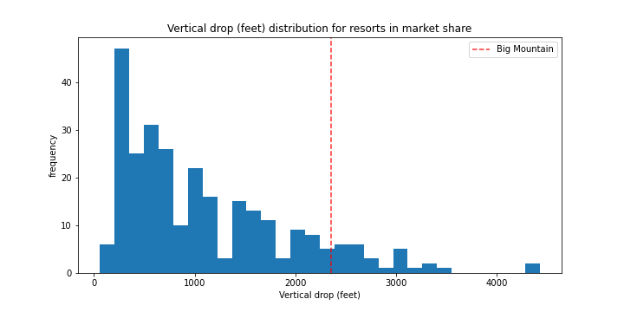
Modeling Results and Analysis
Linear Regression Mode
Mean Absolute Error
$11.79
Getting Better
Results / Analysis
Vertical drop -> strongest positive feature
Snow making -> people like guaranteed snow

Slide 6
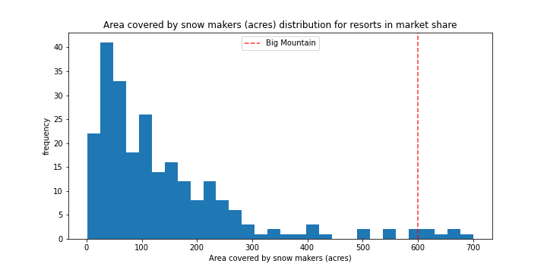
Modeling Results and Analysis
Random Forest Model
Winner!!!
Mean Absolute Error
$9.53
Results / Analysis
Shares top features with LR model
These features were also highlighted in EDA

Slide 7
Summary and Conclusion
Modelled Price?
$95.87
Account for MAE
Still room for growth
Big Mountain ranking
Well above average in all strong/positive predictor features
Strengthen argument to raise ticket price
Future Ideas
Scenario 3
Cost - $1.5 million next season
Benefit - supports a $2 ticket price increase
Benefit - Increased revenue next season - $3.5 million

